Slide 1
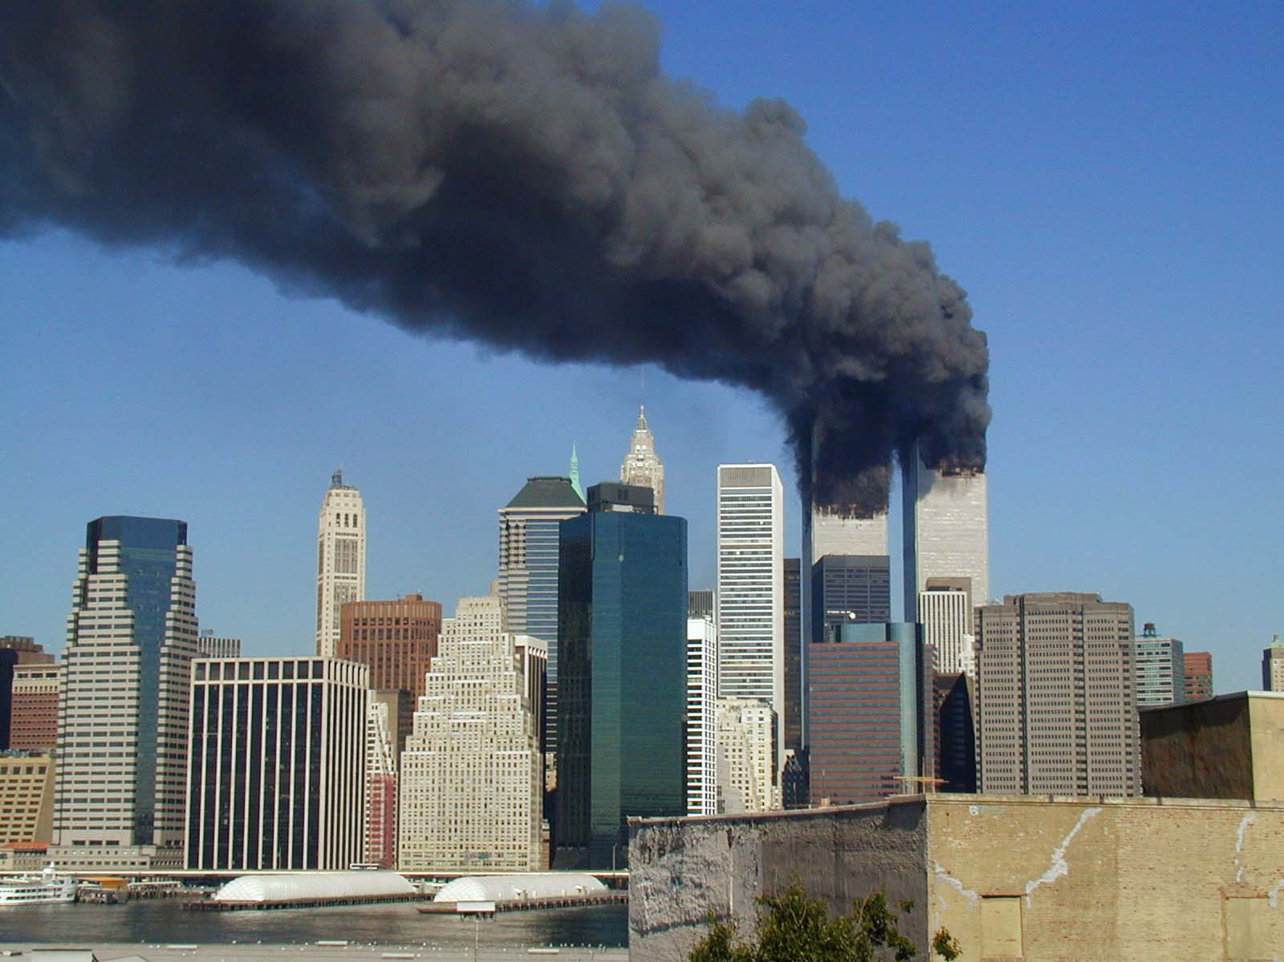
Terrorism
Analysing the Global Terrorism Dataset
Done By: Ng Ho Chi & Melissa Ng SC7 Group 10

Slide 2
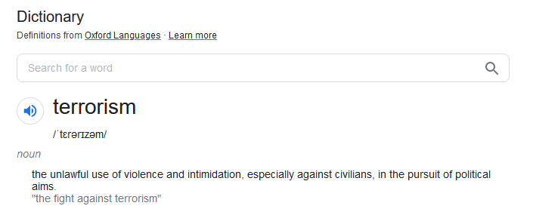

Slide 3
Project Objectives
Identify what determines a successful terrorist attack
Figure out what terrorists really aim to achieve from the attacks

Slide 4
The dataset
EDA
Machine Learning
Final Insights

Slide 5
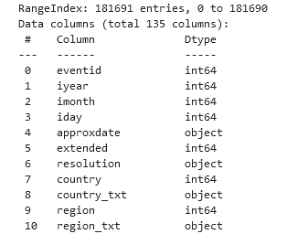
The dataset
EDA
Machine Learning
Final Insights

Slide 6
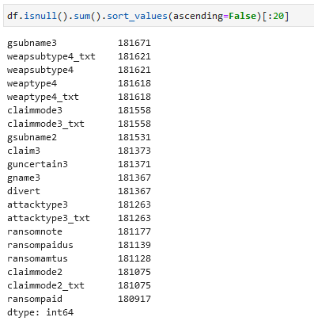
About the dataset
Notes:
The GTD is the most comprehensive unclassified database of terrorist attacks in the world, and is open source, meaning it is free for everyone to use.
Collection of over 180000 events, with 135 different features
Unfortunately, most of the features are unusable in our case, some with majority being null, and others being text-based data.

Slide 7
Imbalanced dataset
Weighted Logistic Regression
Oversampling/Undersampling

Slide 8
The dataset
EDA
Machine Learning
Final Insights

Slide 9
The dataset
EDA
Machine Learning
Final Insights

Slide 10
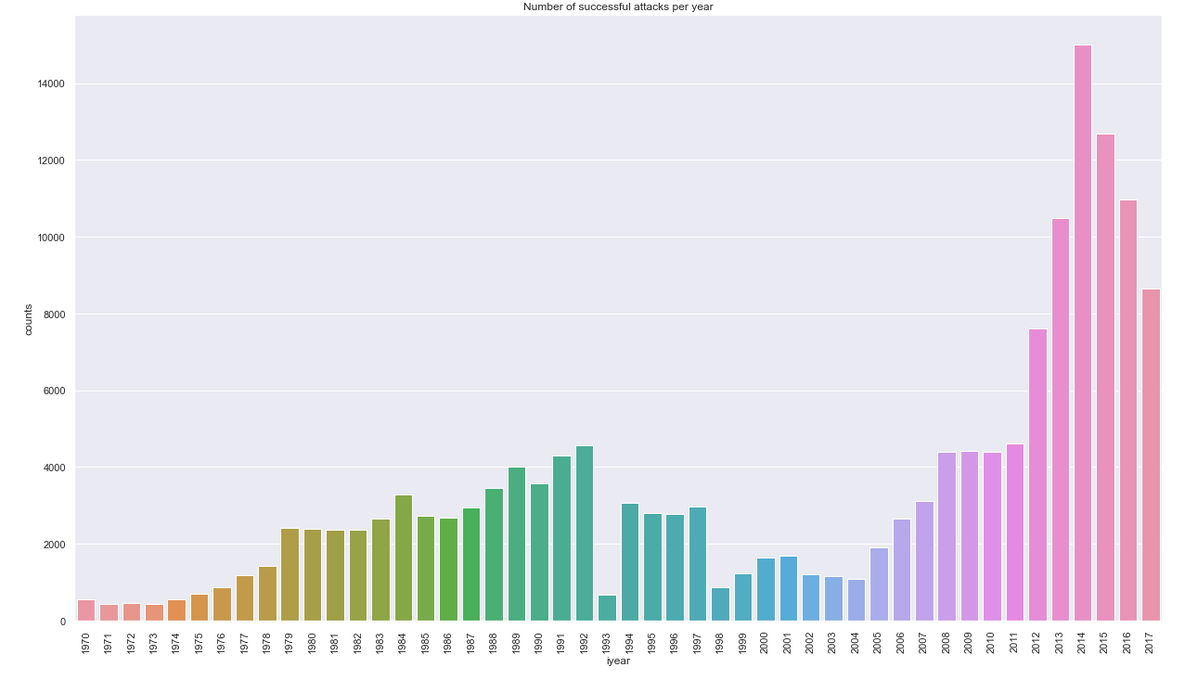
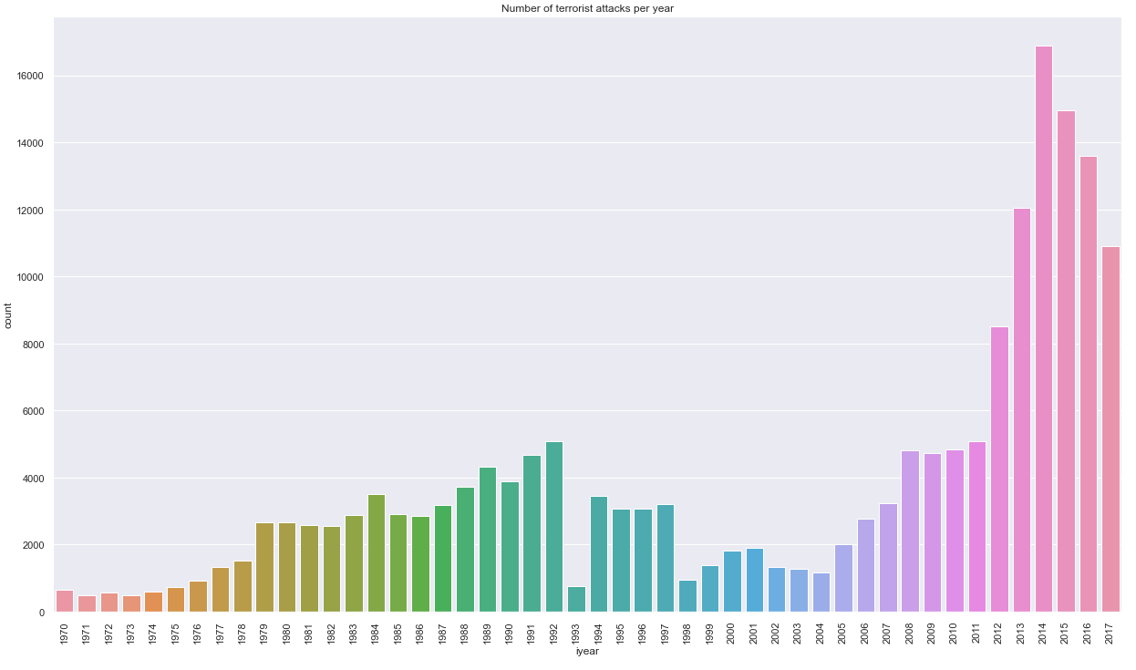
First analyse the number of attacks, number of failed attacks, success, percent of successful to get an idea of the feature we are trying to predict – how skewed, distribution etc. - show number of success:fail
Successful attacks
Total attacks
Notes:
Since our goal was to investigate what contributes to a successful attack ….

Slide 11
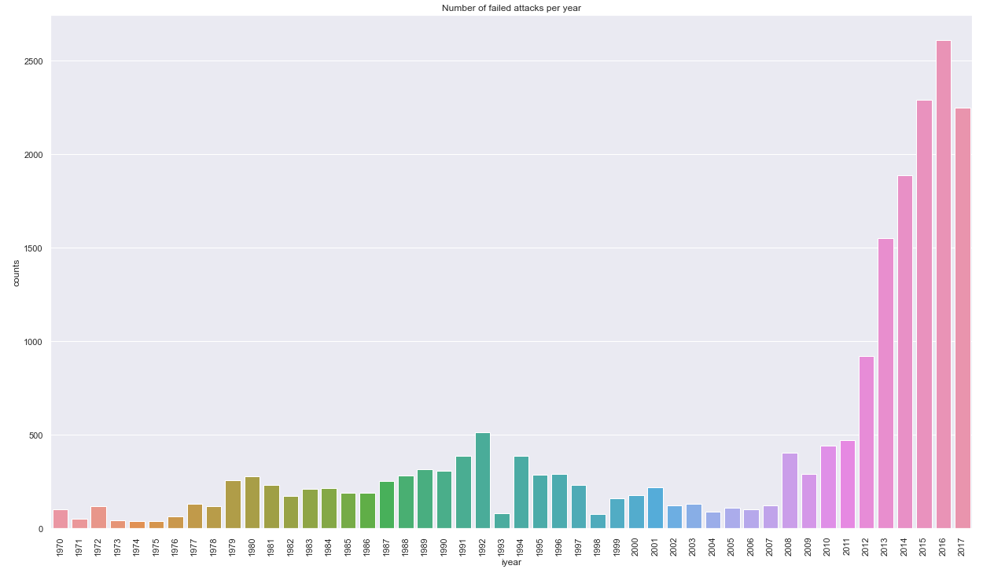
First analyse the number of attacks, number of failed attacks, success, percent of successful to get an idea of the feature we are trying to predict – how skewed, distribution etc. - show number of success:fail
Failed attacks
Successful attacks
Total attacks
Notes:
Since our goal was to investigate what contributes to a successful attack ….

Slide 12
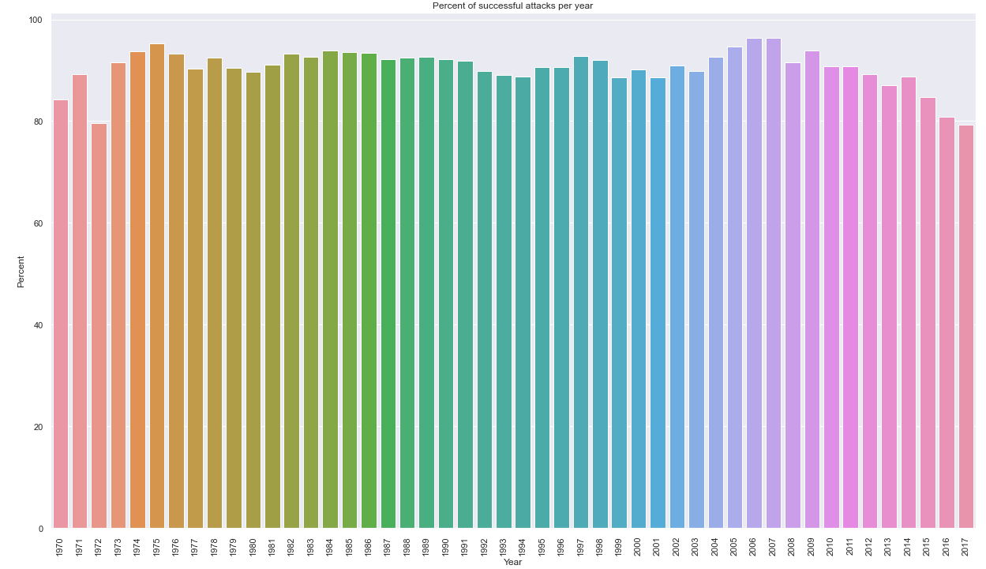
First analyse the number of attacks, number of failed attacks, success, percent of successful to get an idea of the feature we are trying to predict – how skewed, distribution etc. - show number of success:fail
Successful attacks
% successful
Failed attacks
Total attacks
Notes:
Since our goal was to investigate what contributes to a successful attack ….

Slide 13
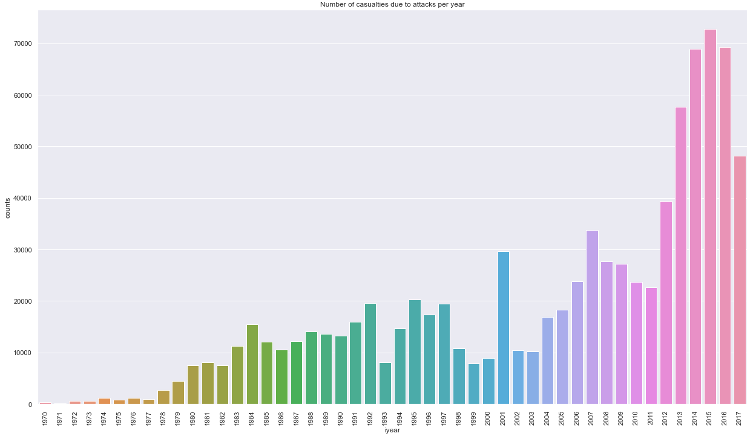
First analyse the number of attacks, number of failed attacks, success, percent of successful to get an idea of the feature we are trying to predict – how skewed, distribution etc. - show number of success:fail
Failed attacks
Successful attacks
% successful
Total attacks
Casualties
Notes:
Since our goal was to investigate what contributes to a successful attack ….

Slide 14
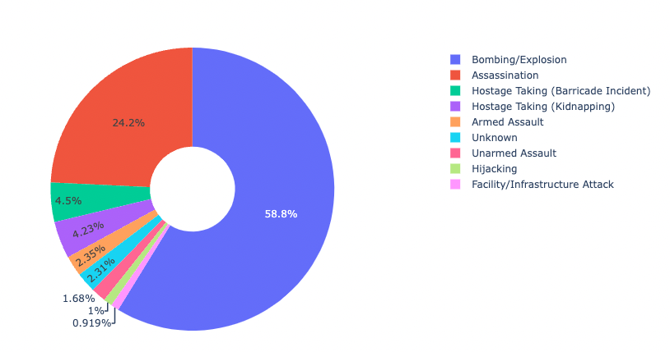
Failed attacks
Successful attacks
% successful
Total attacks
Casualties
Casualties /Attack Types
Notes:
Since our goal was to investigate what contributes to a successful attack ….

Slide 15
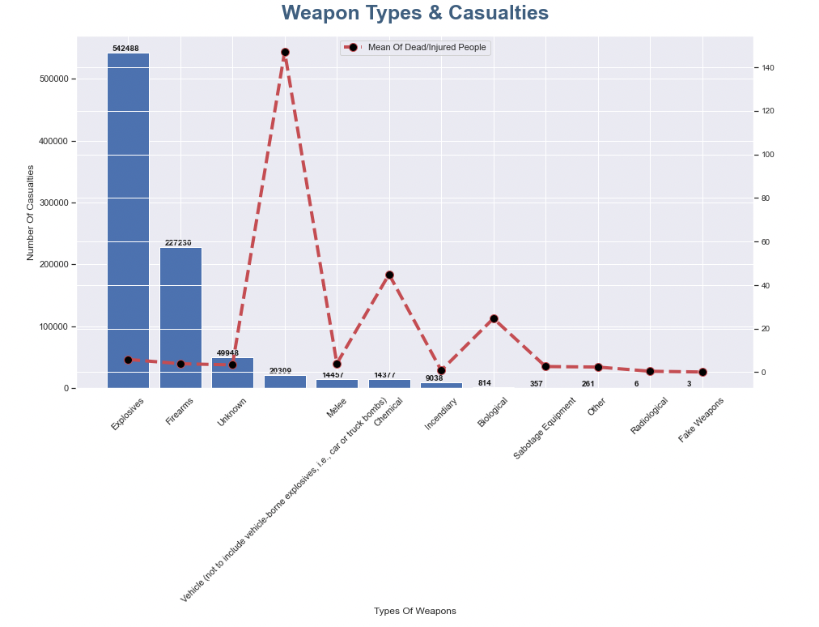
Casualties
Casualties /Attack Types
Casualties /Weapon Types
Notes:
Since our goal was to investigate what contributes to a successful attack ….

Slide 16
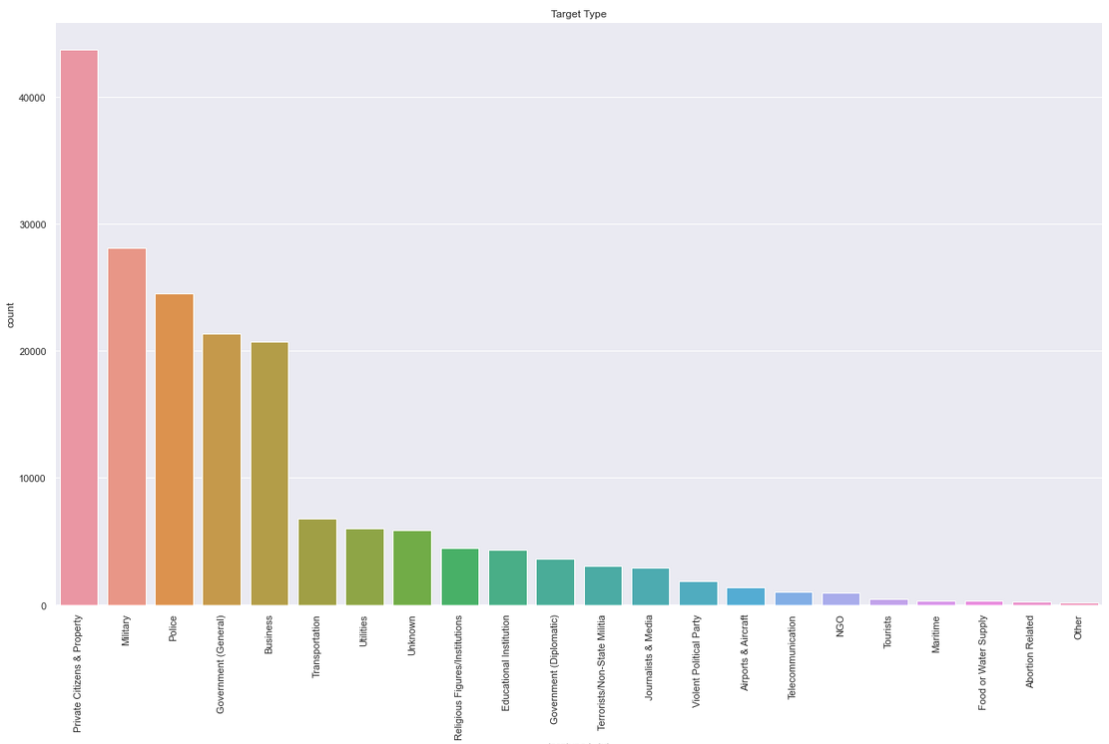
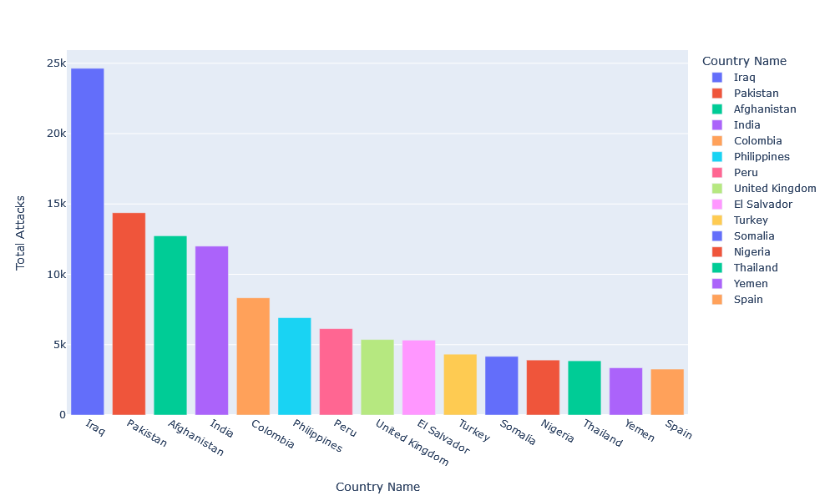
Casualties /Attack Types
Attack/Country
Casualties /Weapon Types
Attacks/target type
Notes:
Since our goal was to investigate what contributes to a successful attack ….

Slide 17
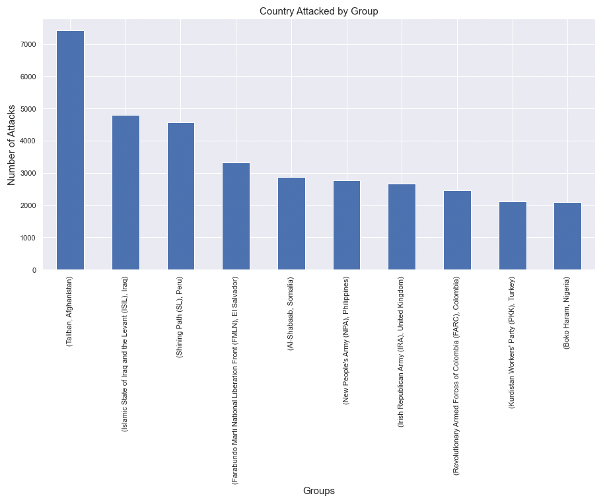
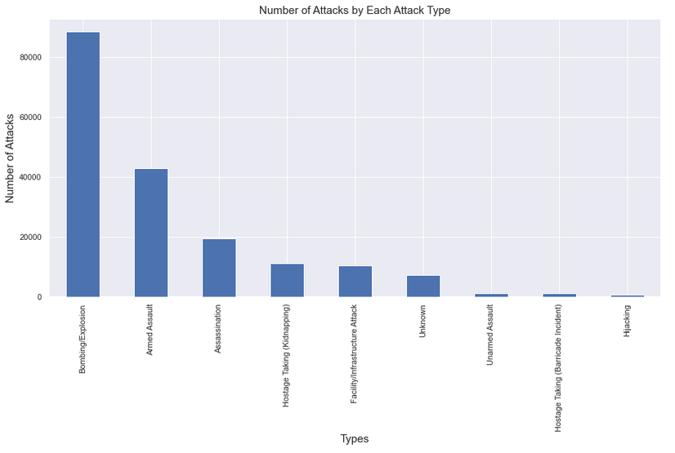
Casualties /Weapon Types
Casualties
Attack/Country
Attacks/target type
Country Attacked/Group
Most popular attack types
Notes:
Since our goal was to investigate what contributes to a successful attack ….

Slide 18
Attack/Country
Attacks/target type
Country Attacked/Group
Most popular attack types
Notes:
Since our goal was to investigate what contributes to a successful attack ….

Slide 19
Country Attacked/Group
Most popular attack types

Slide 20
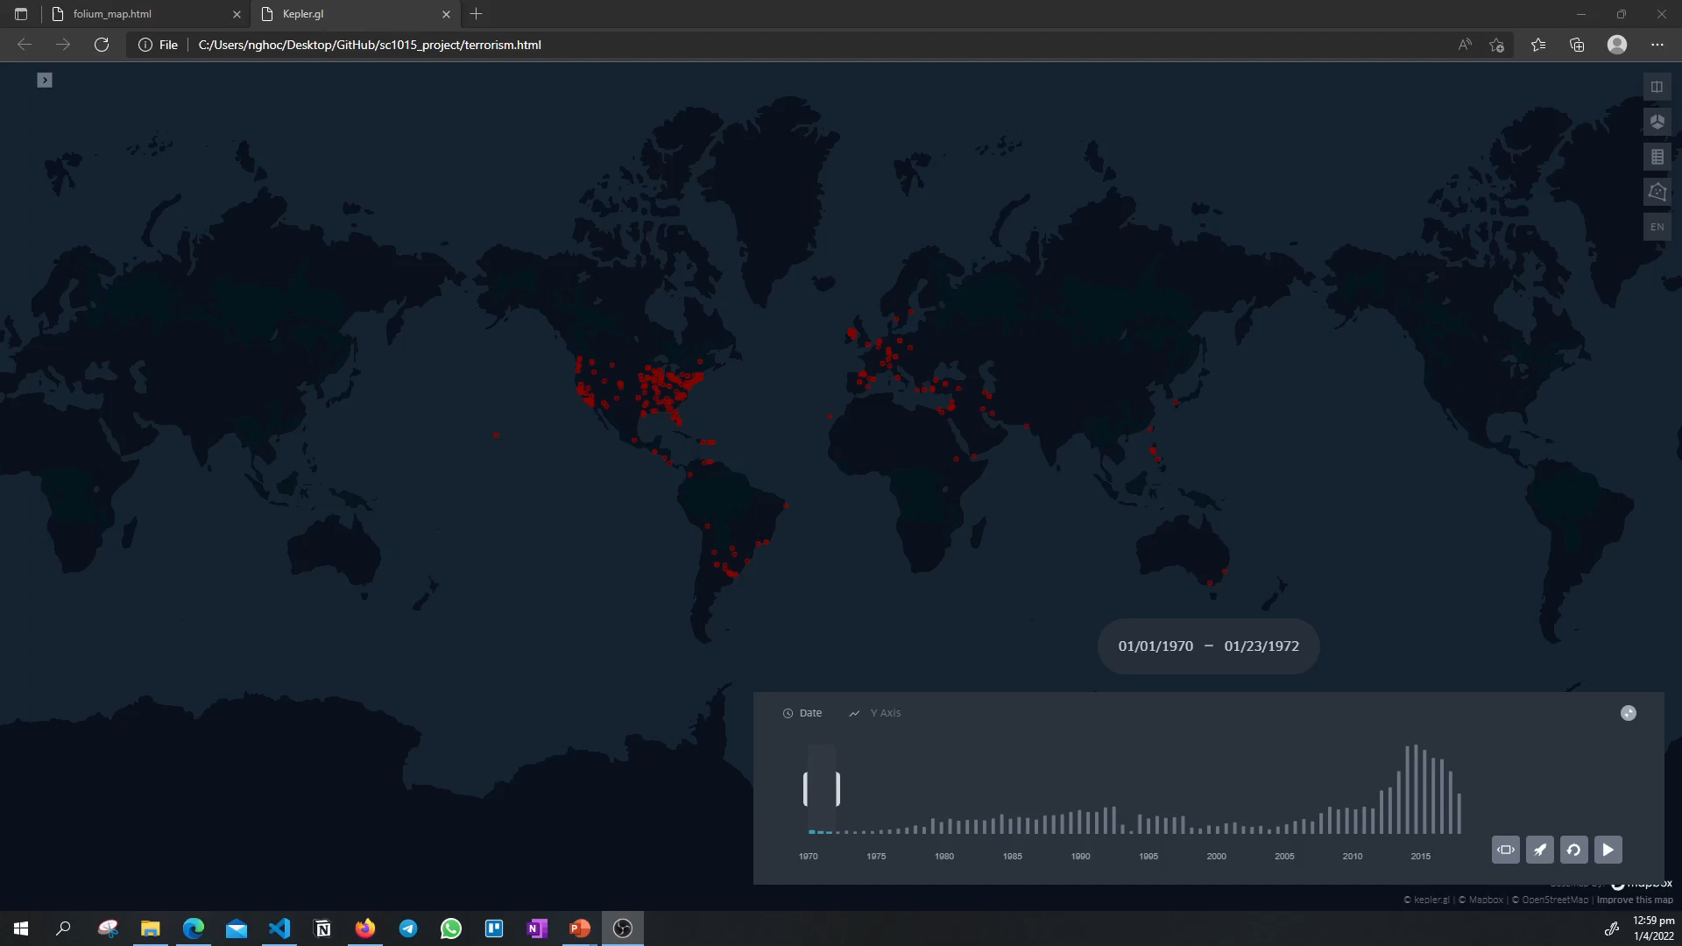
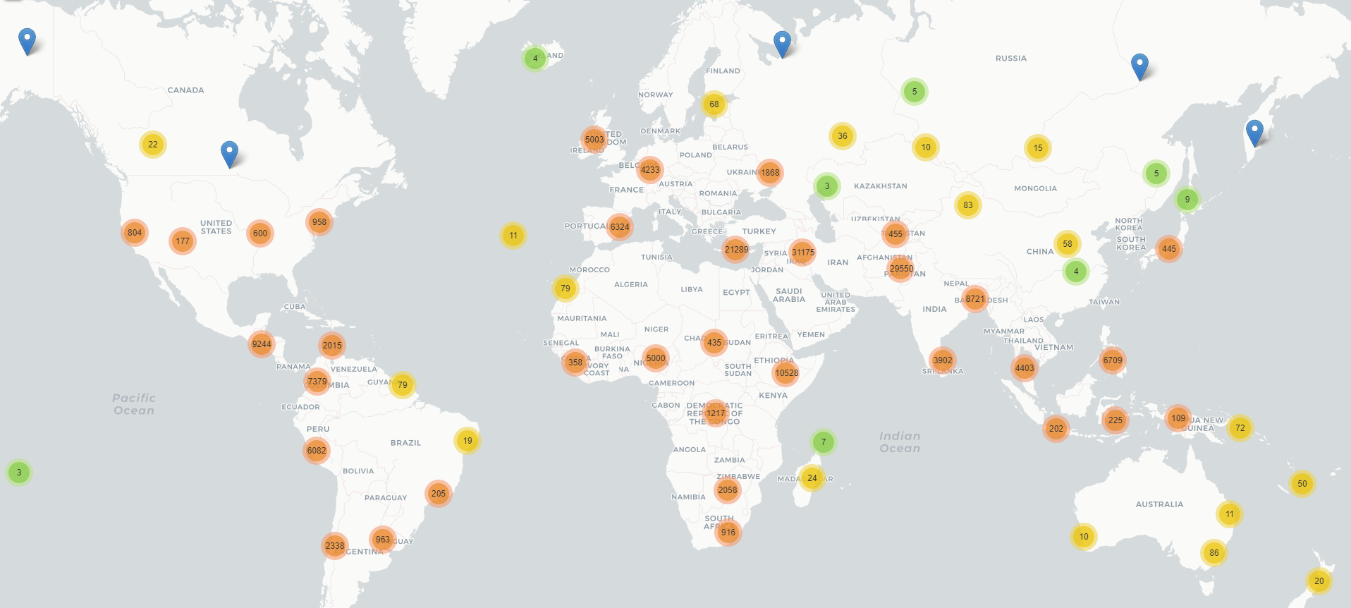

Slide 21
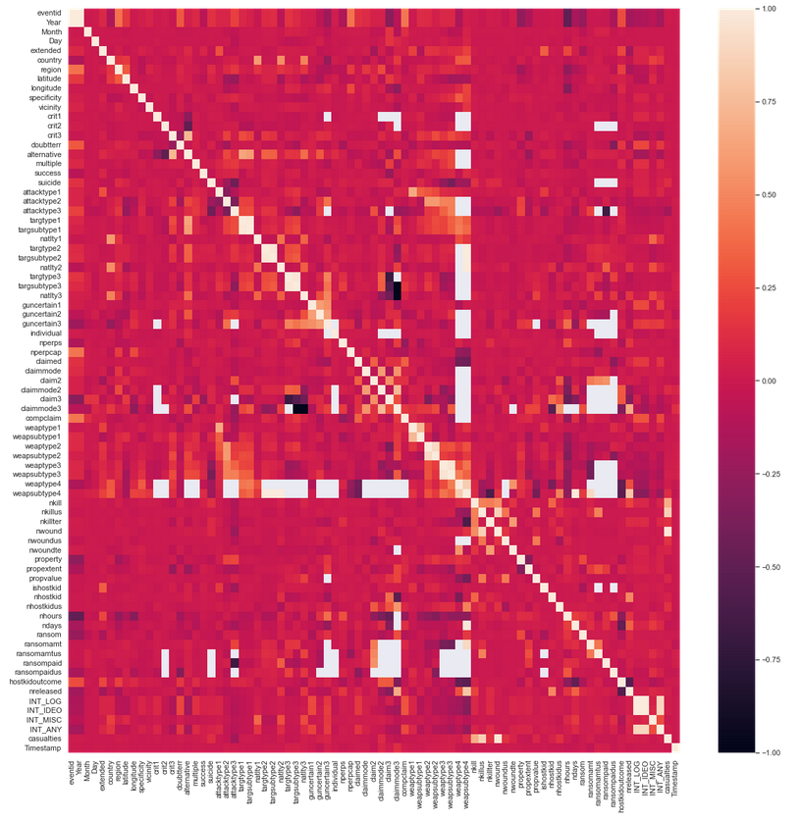
Not very useful
Too cluttered
Most aren’t correlated

Slide 22
Not very useful
Too cluttered
No strong correlation

Slide 23
Data preprocessing
Notes:
To make our lives easier, and for a more reliable model for our machine learning process, we will preprocess the data.

Slide 24
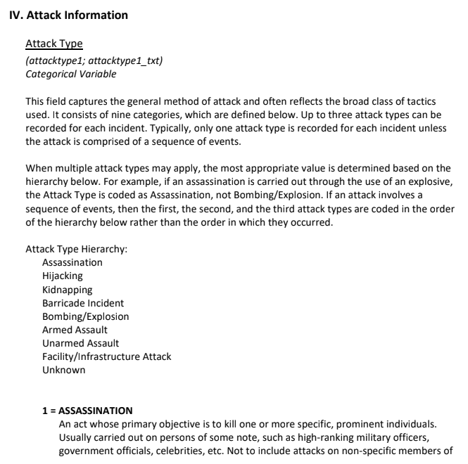

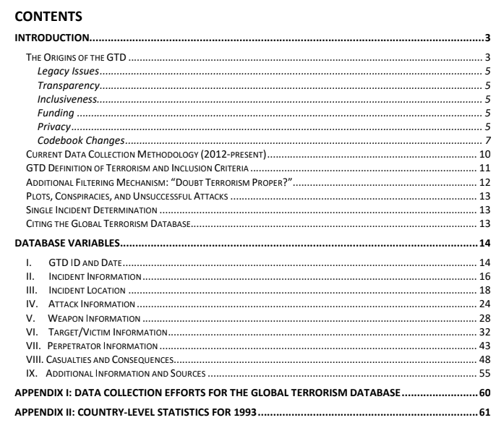
Selection of variables
Notes:
Extremely detailed descriptions of each variable

Slide 25
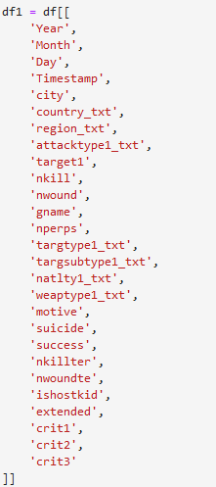
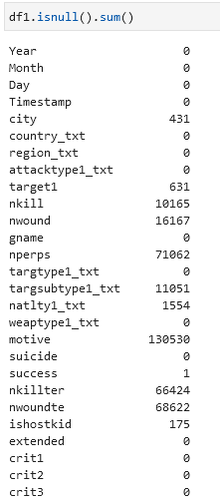
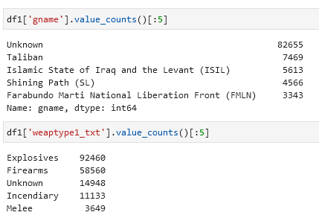
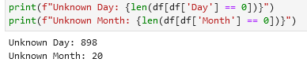
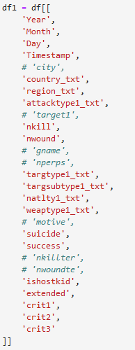
Drop missing data, as well as “unknown” - Removing data points with too many unknown/missing data so as to not drop too much of our sample - Remove text data
27 manually chosen variables
Almost Half
Still less than 10%

Slide 26
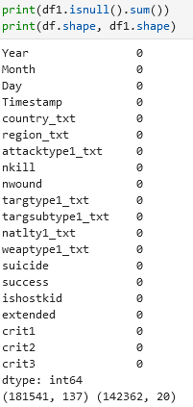
Drop missing data, as well as “unknown” - Removing data points with too many unknown/missing data so as to not drop too much of our sample - Remove text data
27 manually chosen variables
Almost Half
Still less than 10%

Slide 27
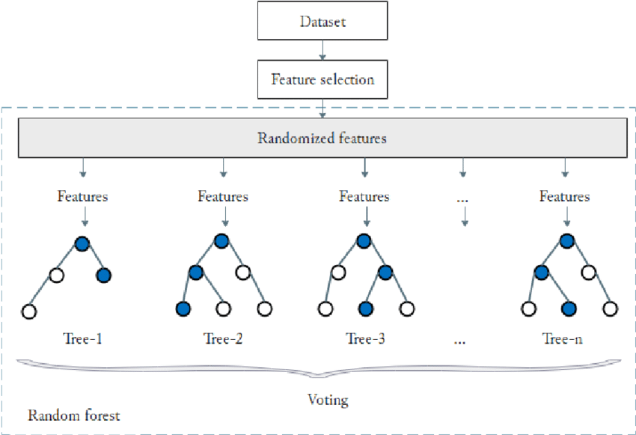
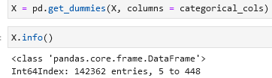
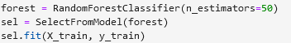
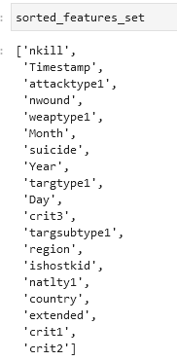
To further gather information on dataset, used random forest to select features
Feature Selection with Random Forest
One-Hot Encoding

Slide 28
To further gather information on dataset, used random forest to select features
One-Hot Encoding
Feature Selection with Random Forest

Slide 29
To further gather information on dataset, used random forest to select features
One-Hot Encoding
Feature Selection with Random Forest
Top 5 generally stay top 5

Slide 30
After selecting the top features using Random Forest, we cleaned the data again

Slide 31
The dataset
EDA
Machine Learning
Final Insights

Slide 32
The dataset
EDA
Machine Learning
Final Insights

Slide 33
Project Objectives
Identify what determines a successful terrorist attack
Figure out what terrorists really aim to achieve from the attacks

Slide 34
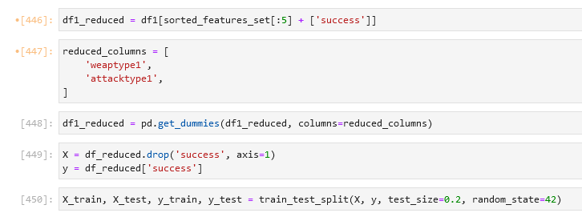
Project Objectives
Used a set of the top 5 most important features as determined by our feature selection
One-hot encoded the categorical data
Identify what determines a successful terrorist attack
Figure out what terrorists really aim to achieve from the attacks
Find the features that are most important in determining the attack
Predicting whether a terrorist attack would be successful based on the features - classification problem
Analysis of the motive behind the attack.
Analysis of additional information located in the summary column.
Use the summary column to predict motive

Slide 35
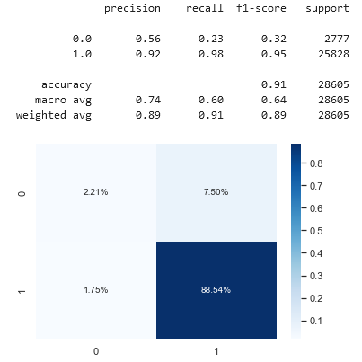
Project Objectives
Identify what determines a successful terrorist attack
Used a set of the top 5 most important features as determined by our feature selection
One-hot encoded the categorical data
Used a constant random state so we can ensure that the same output is produced to reduce variability
Find the features that are most important in determining the attack
Predicting whether a terrorist attack would occur based on the features - classification problem
Random Forest Classifier

Slide 36
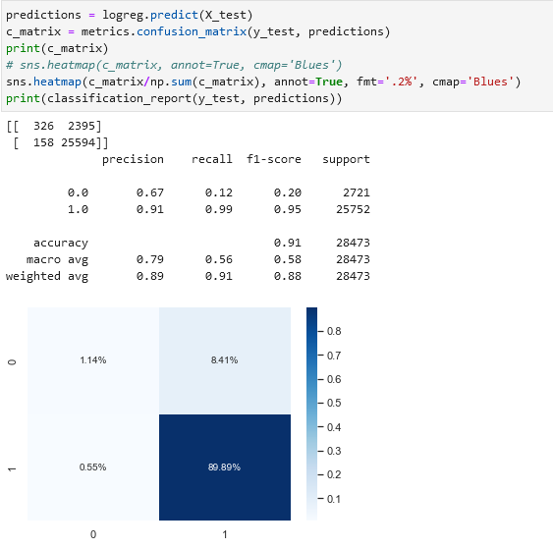
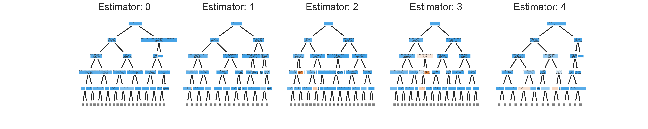
Logistic Regression
Used a set of the top 5 most important features as determined by our feature selection
One-hot encoded the categorical data
Used a constant random state so we can ensure that the same output is produced to reduce variability
Project Objectives
Identify what determines a successful terrorist attack
Random Forest Classifier
Find the features that are most important in determining the attack
Predicting whether a terrorist attack would occur based on the features - classification problem

Slide 37
Identify what determines a successful terrorist attack
Weighted
Random Forest Classifier
Logistic Regression
Although accuracy is high, recall is very low – not a very good model…

Slide 38
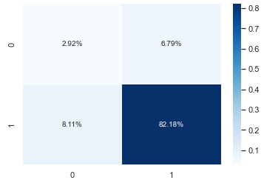


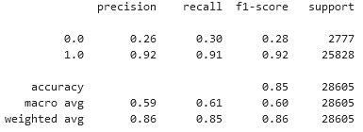
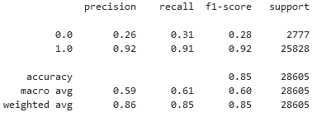
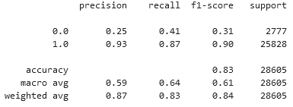
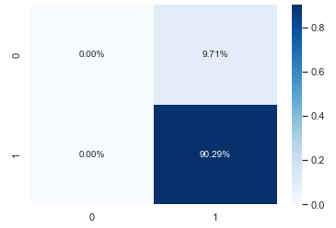


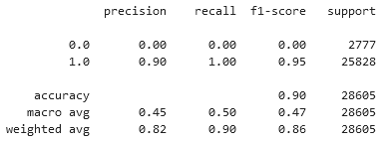
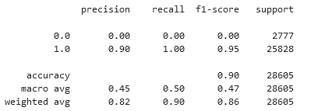
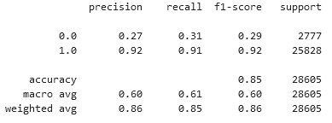
4 Variables
5 Variables
Categorical Variables
1 Variable
2 Variables
3 Variables
Logistic Regression
Weighted

Slide 39
4 Variables
5 Variables
Categorical Variables
Logistic Regression
Weighted
1 Variable
2 Variables
3 Variables

Slide 40
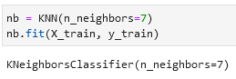
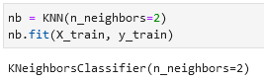

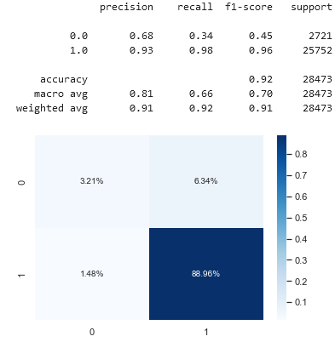
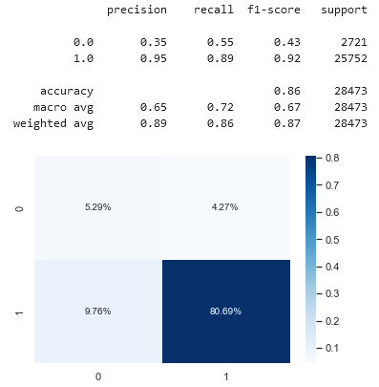
K-Nearest Neigbours

Slide 41
K-Nearest Neigbours

Slide 42
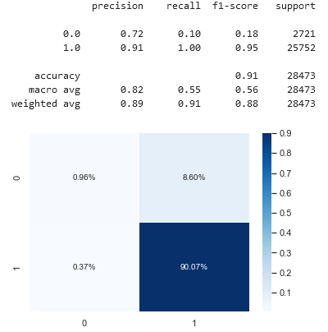

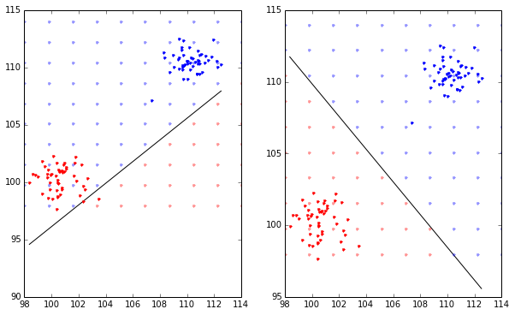
Support Vector Classification
Unweighted
Weighted
Notes:
SVM works by mapping data to a higher dimensional feature space so that data points can be categorized. If it’s linear of course, the results will give us a line that’s best fit among our data that divides the 2 classes.
Because from previous analysis of the dataset, we do understand that our dataset has an unbalanced number of 1s to 0s. Therefore, we tried to find the optimal separating of the hyperplane with automatically correcting the unbalanced classes. It seems that after this test, the precision dropped significantly, while the recall and f1-score increased. The accuracy also decreased, but from this comparison, it does seem that the unweighted model seems to be better than the weighted one. Probably because we customized the weights manually.

Slide 43
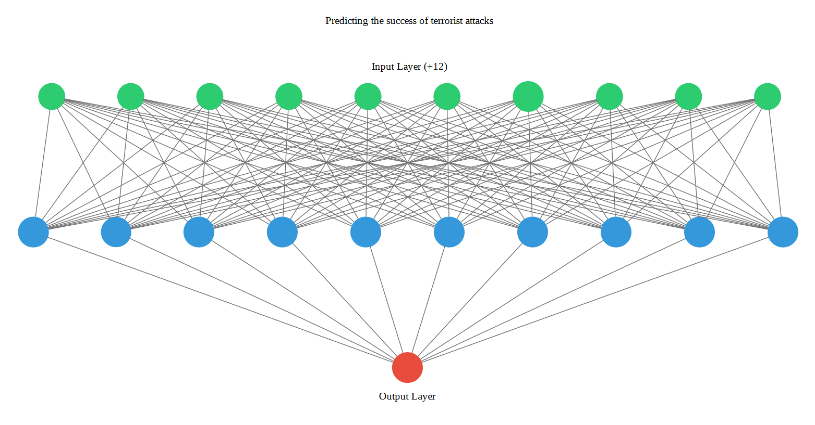
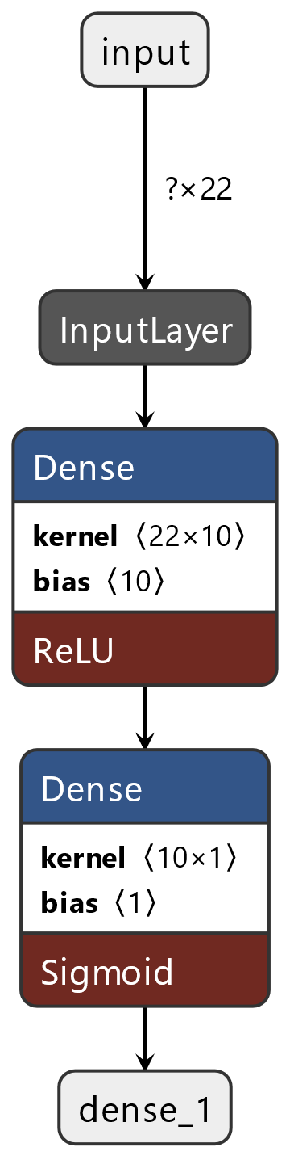
Neural Networks
Notes:
Moving on to the next model that we tried, we attempted to use neural networks to train our model because we thought that we might be able to obtain a better predictor. The concept of neural networks is really interesting, NN could also be known as ANN, which is a subset of machine learning and a part of deep learning algorithms. Where they have interconnection between nodes and mimicks the nurons in the human brain. Recognising hidden patterns and correlations in raw data, then condensing it into the important feactures and eventually producing an output based on the previous layers.

Slide 44


Neural Networks
Unweighted
Weighted
Notes:
The results of the neural networks however were quite similar to the non-neural network models.

Slide 45
Identify what determines a successful terrorist attack
Figure out what terrorists really aim to achieve from the attacks
Find the features that are most important in determining the attack
Predicting whether a terrorist attack would be successful based on the features - classification problem
Analysis of the motive behind the attack.
Analysis of additional information located in the summary column.
Use the summary column to predict motive

Slide 46


Figure out what terrorists really aim to achieve from the attacks
Making use of the “unclean” dataset – text data needs its own pre-processing
Analysing text data to extract information
Preprocessing
Changing text to lowercase
Removing punctuation and digits
Remove stop words
Lemmatization

Slide 47

Figure out what terrorists really aim to achieve from the attacks
Making use of the “unclean” dataset – text data needs its own pre-processing
Analysing text data to extract information
Preprocessing
Changing text to lowercase
Removing punctuation and digits
Remove stop words
Lemmatization

Slide 48
Figure out what terrorists really aim to achieve from the attacks
Making use of the “unclean” dataset – text data needs its own pre-processing
Analysing text data to extract information
Preprocessing
Changing text to lowercase
Removing punctuation and digits
Remove stop words
Lemmatization

Slide 49
Motive Column

Slide 50



Bag-of-Words model + Latent Dirichlet Allocation
Most populated topic
Least populated topic

Slide 51


Bag-of-Words model + Latent Dirichlet Allocation
Least populated topic
Most populated topic
TF-IDF

Slide 52
TF-IDF model + Latent Dirichlet Allocation
TF-IDF
Most populated topic
Least populated topic

Slide 53



Bag-of-Words model + Latent Dirichlet Allocation
TF-IDF
Most populated topic
Least populated topic
Evaluation
BOW
TF-IDF

Slide 54
Summary Column

Slide 55


Bag-of-Words model

Slide 56




Machine Learning Models
Stochastic Gradient Descent Classifier
Kernel SVM

Slide 57


Machine Learning Models
Kernel SVM
Logistic Regression

Slide 58


Machine Learning Models
Kernel SVM
Logistic Regression
Decision Tree Classifier

Slide 59


Machine Learning Models
Logistic Regression
Decision Tree Classifier
Random Forest Classifier

Slide 60


Machine Learning Models
Decision Tree Classifier
Random Forest Classifier
K-Nearest Neighbours

Slide 61


Machine Learning Models
Random Forest Classifier
K-Nearest Neighbours
AdaBoost

Slide 62


Boosting Algorithms
K-Nearest Neighbours
AdaBoost
Gradient Boosting

Slide 63
Boosting Algorithms
Gradient Boosting
AdaBoost

Slide 64
The dataset
EDA
Machine Learning
Final Insights

Slide 65
The dataset
EDA
Machine Learning
Final Insights

Slide 66
Project Objectives
Identify what determines a successful terrorist attack
Figure out what terrorists really aim to achieve from the attacks

Slide 67
Project Objectives
Identify what determines a successful terrorist attack
Analysis of features to determine successful terrorist attack
Design solutions to tackle these main features to prevent successful attacks.
Allows us to mitigate and minimize damage done.
Spread crowds out to minimize casualties
Random Forest Classifier

Slide 68
Project Objectives
Identify what determines a successful terrorist attack
Analysis of features to determine successful terrorist attack
Design solutions to tackle these main features to prevent successful attacks.
Allows us to mitigate and minimize damage done.
More stringent checks on behavior corresponding to certain attack types
Random Forest Classifier

Slide 69
Project Objectives
Identify what determines a successful terrorist attack
Analysis of features to determine successful terrorist attack
Design solutions to tackle these main features to prevent successful attacks.
Allows us to mitigate and minimize damage done.
Ban the use of most popular weapon types
Random Forest Classifier

Slide 70
Project Objectives
Identify what determines a successful terrorist attack
Analysis of features to determine successful terrorist attack
Design solutions to tackle these main features to prevent successful attacks.
Allows us to mitigate and minimize damage done.
And so on…
Random Forest Classifier

Slide 71
Project Objectives
Identify what determines a successful terrorist attack
Figure out what terrorists really aim to achieve from the attacks

Slide 72
Figure out what terrorists really aim to achieve from the attacks
Analysis of motive to determine goal of terrorists
Targeting the motives that are the most harmful and common would serve to reduce the number of successful terror attacks.
Terrorists will not have reason to attack
Creating an environment where all individuals are valued

Slide 73
Figure out what terrorists really aim to achieve from the attacks
Analysis of motive to determine goal of terrorists
Targeting the motives that are the most harmful and common would serve to reduce the number of successful terror attacks.
Terrorists will not have reason to attack
Allow for freedom to practice religion

Slide 74
Figure out what terrorists really aim to achieve from the attacks
Analysis of motive to determine goal of terrorists
Targeting the motives that are the most harmful and common would serve to reduce the number of successful terror attacks.
Terrorists will not have reason to attack
Fair wages

Slide 75
Figure out what terrorists really aim to achieve from the attacks
Analysis of motive to determine goal of terrorists
Targeting the motives that are the most harmful and common would serve to reduce the number of successful terror attacks.
Terrorists will not have reason to attack
Build trust in citizens of the country

Slide 76
Figure out what terrorists really aim to achieve from the attacks
Analysis of motive to determine goal of terrorists
Targeting the motives that are the most harmful and common would serve to reduce the number of successful terror attacks.
Terrorists will not have reason to attack
Ensure everyone is fairly represented

Slide 77






Figure out what terrorists really aim to achieve from the attacks
Analysis of motive to determine goal of terrorists
Targeting the motives that are the most harmful and common would serve to reduce the number of successful terror attacks.
Terrorists will not have reason to attack
Ethical education in schools
Singapore’s Pillars of Total Defence

Slide 78

Figure out what terrorists really aim to achieve from the attacks
Analysis of motive to determine goal of terrorists
Targeting the motives that are the most harmful and common would serve to reduce the number of successful terror attacks.
Terrorists will not have reason to attack
Singapore’s Pillars of Total Defence
Ethical education in schools

Slide 79
Thank you

Slide 80
Contributions
Ng Ho Chi
Melissa Ng
Motivation Discussion
Data Analysis
Creation of HTML Maps
EDA
Dataset Cleaning
Various Model Training
Model Optimization
Slides + Animation
Video + Audio Editing
Motivation Discussion
Data Analysis
EDA
Dataset Cleaning
Various Model Training
BOW + LDA
Model Optimization
Results Evaluation
Video + Audio Editing

